Slide 1
Dell EMC Ready System for VDI on VxRail

Slide 2



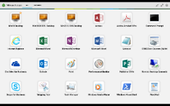
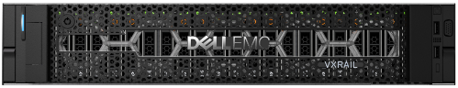
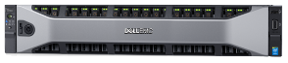
Simply Plug-in & Power-up
95%
Faster initiation for 1st VxRail appliance
47%
Faster to provision 10 desktop VMs
ALL-IN-ONE Appliance with VxRail
Leading Desktop and App Virtualization Solution from VMware
High Performance Wyse Thin and Zero Clients from Dell
96% Faster to add a new appliance
Notes:
High Bandwidth test results include:
Large Block Sequential Read Cache Hits (from memory). The V2 test was run with Local Cache Hits (no fabric)…
- VMAX 2 = 83GB/s
- Hitachi VSP = 17GB/s
- IBM DS8800 = 16GB/s
The promise is simple. Simplified end-to-end lifecycle management with VxRail.
VMware Hyper-Converged Software automatically builds, configure and validates your VxRail appliance accelerating your agility and time-to-value. Customers will be able to set up a VMware cluster in 15min from power-on to provisioning VMs. No one else can do this. This is fully automated. To achieve this, over 200 config steps that would otherwise have to happen in a VMware deployment – whether on a “standalone appliance”, or a DIY server with VSAN - are going to be automatic. The customer’s experience (when properly plugged into the network) is really pristine. Speaking of network, VxRail will also self-validate the network with an onboard pre-installation validation and instruct customers on how to proceed. And then adding a new appliance into that environment is as simple as saying “I have an appliance. I want to attach it to the existing cluster.” It takes 5 minutes, fully configured.
This is the promise we make to customers, and deliver upon.

Slide 3







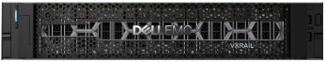
Ready System for VDI Logical Architecture
Endpoints
VMware vCenter Appliance
SQL Server
VDI Broker Components
VxRail Appliance Manager
Platform
Services Controller
Log Insight
VMware vSphere 6.5 – Infrastructure
Virtual Desktops
VxRail Cluster

Slide 4
Scaling Up to 2000 VMs
Notes:
The components are scaled either horizontally (by adding additional physical and virtual servers to each component of the solution architecture scales independently according to the desired number of supported users. Additional appliance nodes can be added at any time to expand the vSAN SDS pool in a modular fashion. The scaling limit for vSAN is restricted due to the limits of the Hypervisor so 64 Nodes in total per Cluster. The recommended limit by VMware with regards to the amount of VMs per Cluster is 2,000 so taking this into consideration we need 10 compute nodes for with 200 Task User VMs per Node. The image below shows a 2000 user Horizon with vSAN Block.

Slide 5
Scaling out to 10,000 VMs
Notes:
The recommendation from VMware is not to exceed 2,000 VMs/Sessions per Block and once we have more than 2000 VMs we would then split the management and compute into separate vSAN Clusters. The example below shows a scale out of a 10,000 user Horizon vSAN Pod with 2000 user blocks, each block contains its own Virtual Center, Horizon connection & composer servers.

Slide 6
Solution Performance and Testing
With VMware vSphere Horizon
Host Config | Hypervisor | Broker & Provisioning | Workload | Template | User Density
V570F B5 | ESXi 6.5 | Horizon 7.3.2 Instant Clones | Task Worker | Windows 10 & Office 2016 | 240
V570F B5 | ESXi 6.5 | Horizon 7.3.2 Instant Clones | Knowledge Worker | Windows 10 & Office 2016 | 155
V570F B5 | ESXi 6.5 | Horizon 7.3.2 Instant Clones | Power Worker | Windows 10 & Office 2016 | 120
V570F B5 | ESXi 6.5 | Horizon 7.3.2 Instant Clones | M60Q-1Q | Windows 10 & Office 2016 | 48
V570F B5 | ESXi 6.5 | Horizon 7.3.2 Instant Clones | M10Q-1Q | Windows 10 & Office 2016 | 64

Slide 7
Testing Workload
With VMware vSphere Horizon
Profile Name | Workload
Task Worker | Login VSI Task worker
Knowledge Worker | Login VSI Knowledge worker
Power Worker | Login VSI Power worker
Graphics LVSI Power + ProLibrary | Graphics - Login VSI Power worker with ProLibrary
Graphics LVSI Custom | Graphics – LVSI Custom
Further information for each workload can be found on Login VSI’s website.

Slide 8
Resource Utilization Thresholds
With VMware vSphere Horizon
Parameter | Pass/Fail Threshold
Physical Host CPU Utilization | 100%
Physical Host Memory Utilization | 85%
Network Throughput | 85%
Storage IO Latency | 20ms
Notes:
Poor end-user experience is one of the main risk factors when implementing desktop virtualization but a root cause for poor end-user experience is resource contention: hardware resources at some point in the solution have been exhausted, thus causing the poor end-user experience. In order to ensure that this does not happen, PAAC on Dell EMC for VDI solutions monitors the relevant resource utilization parameters and applies relatively conservative thresholds as shown in the table below. Thresholds are carefully selected to deliver an optimal combination of good end-user experience and cost-per-user, while also providing burst capacity for seasonal / intermittent spikes in usage. Utilization within these thresholds is used to determine the number of virtual applications or desktops (density) that are hosted by a specific hardware environment (i.e. combination of server, storage and networking) that forms the basis for a Dell EMC for VDI RA

Slide 9
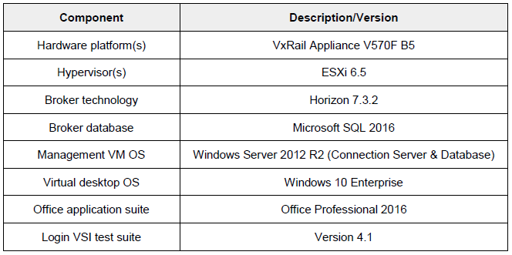
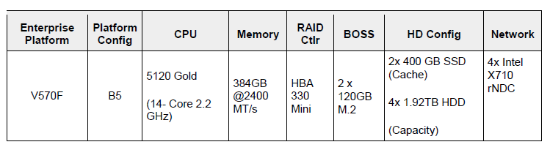
Hardware and Software Test Components
With VMware vSphere Horizon

Slide 10
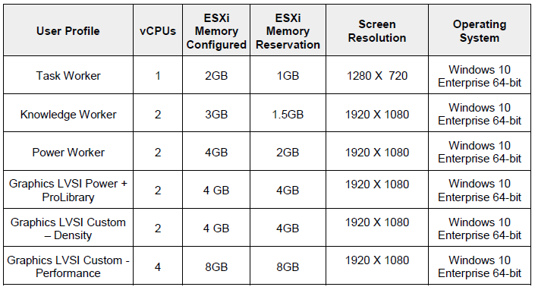
Compute VM Configurations
With VMware vSphere Horizon

Slide 11
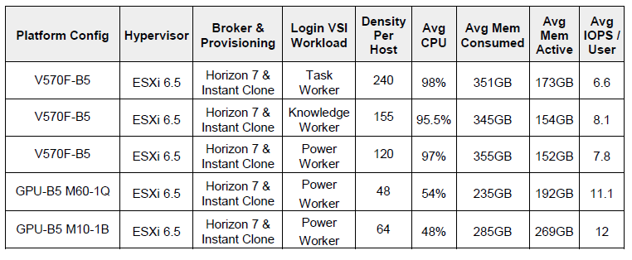
Test Results and Analysis
With VMware vSphere Horizon
Notes:
Density per Host: Density reflects number of users per compute host that successfully completed the workload test within the acceptable resource limits for the host. For clusters, this reflects the average of the density achieved for all compute hosts in the cluster.
Avg CPU: This is the average CPU usage over the steady state period. For clusters, this represents the combined average CPU usage of all compute hosts. On the latest Intel series processors, the ESXi host CPU metrics will exceed the rated 100% for the host if Turbo Boost is enabled (by default). An additional 35% of CPU is available from the Turbo Boost feature but this additional CPU headroom is not reflected in the VMware vSphere metrics where the performance data is gathered. Therefore, CPU usage for ESXi hosts is adjusted and a line indicating the potential performance headroom provided by Turbo boost is included in each CPU graph. 68 Dell EMC VxRail Appliance with VMware Horizon – Reference Architecture
Avg Consumed Memory: Consumed memory is the amount of host physical memory consumed by a virtual machine, host, or cluster. For clusters, this is the average consumed memory across all compute hosts over the steady state period.
Avg Mem Active: For ESXi hosts, active memory is the amount of memory that is actively used, as estimated by VMkernel based on recently touched memory pages. For clusters, this is the average amount of guest “physical” memory actively used across all compute hosts over the steady state period.
Avg IOPS/User: IOPS calculated from the average Disk IOPS figure over the steady state period divided by the number of users.
Avg Net Mbps/User: Amount of network usage over the steady state period divided by the number of users. For clusters, this is the combined average of all compute hosts over the steady state period divided by the number of users on a host.

Slide 12
Solution Performance and Testing
With Citrix XenDesktop
Host Config | Hypervisor | Broker & Provisioning | Workload | Template | User Density
V570F B5 | ESXi 6.5 | XD 7.15, MCS linked clones | Task Worker | Windows 10 & Office 2016 | 210
V570F B5 | ESXi 6.5 | XD 7.15, MCS linked clones | Knowledge Worker | Windows 10 & Office 2016 | 140
V570F B5 | ESXi 6.5 | XD 7.15, MCS linked clones | Power Worker | Windows 10 & Office 2016 | 120

Slide 13
Testing Workload
With Citrix XenDesktop
Profile Name | Workload
Task Worker | Login VSI Task worker
Knowledge Worker | Login VSI Knowledge worker
Power Worker | Login VSI Power worker
Graphics LVSI Power + ProLibrary | Graphics - Login VSI Power worker with ProLibrary
Graphics LVSI Custom | Graphics – LVSI Custom
Further information for each workload can be found on Login VSI’s website.

Slide 14
Resource Utilization Thresholds
With Citrix XenDesktop
Parameter | Pass/Fail Threshold
Physical Host CPU Utilization | 100%
Physical Host Memory Utilization | 85%
Network Throughput | 85%
Storage IO Latency | 20ms
*Turbo mode is enabled; therefore, the CPU threshold is increased as it will be reported as over 100% utilization when running with turbo.
Notes:
Poor end-user experience is one of the main risk factors when implementing desktop virtualization but a root cause for poor end-user experience is resource contention: hardware resources at some point in the solution have been exhausted, thus causing the poor end-user experience. In order to ensure that this does not happen, PAAC on Dell EMC for VDI solutions monitors the relevant resource utilization parameters and applies relatively conservative thresholds as shown in the table below. Thresholds are carefully selected to deliver an optimal combination of good end-user experience and cost-per-user, while also providing burst capacity for seasonal / intermittent spikes in usage. Utilization within these thresholds is used to determine the number of virtual applications or desktops (density) that are hosted by a specific hardware environment (i.e. combination of server, storage and networking) that forms the basis for a Dell EMC for VDI RA

Slide 15
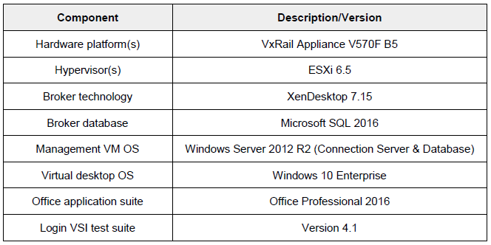
Hardware and Software Test Components
With Citrix XenDesktop

Slide 16
Compute VM Configurations
With Citrix XenDesktop

Slide 17
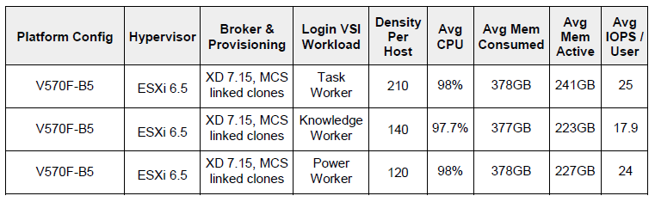
Test Results and Analysis
With Citrix XenDesktop
Notes:
Density per Host: Density reflects number of users per compute host that successfully completed the workload test within the acceptable resource limits for the host. For clusters, this reflects the average of the density achieved for all compute hosts in the cluster.
Avg CPU: This is the average CPU usage over the steady state period. For clusters, this represents the combined average CPU usage of all compute hosts. On the latest Intel series processors, the ESXi host CPU metrics will exceed the rated 100% for the host if Turbo Boost is enabled (by default). An additional 35% of CPU is available from the Turbo Boost feature but this additional CPU headroom is not reflected in the VMware vSphere metrics where the performance data is gathered. Therefore, CPU usage for ESXi hosts is adjusted and a line indicating the potential performance headroom provided by Turbo boost is included in each CPU graph.
Avg Consumed Memory: Consumed memory is the amount of host physical memory consumed by a virtual machine, host, or cluster. For clusters, this is the average consumed memory across all compute hosts over the steady state period.
Avg Mem Active: For ESXi hosts, active memory is the amount of memory that is actively used, as estimated by VMkernel based on recently touched memory pages. For clusters, this is the average amount of guest “physical” memory actively used across all compute hosts over the steady state period.
Avg IOPS/User: IOPS calculated from the average Disk IOPS figure over the steady state period divided by the number of users.
Avg Net Mbps/User: Amount of network usage over the steady state period divided by the number of users. For clusters, this is the combined average of all compute hosts over the steady state period divided by the number of users on a host.

Slide 18
Leaf-Spine Architecture
Notes:
Designed for true linear scaling, Dell EMC VxRail Appliance series leverages a Leaf-Spine network architecture. A Leaf-Spine architecture consists of two network tiers: an L2 Leaf and an L3 Spine based on 40GbE and non-blocking switches. This architecture maintains consistent performance without any throughput reduction due to a static maximum of three hops from any node in the network.

Slide 19
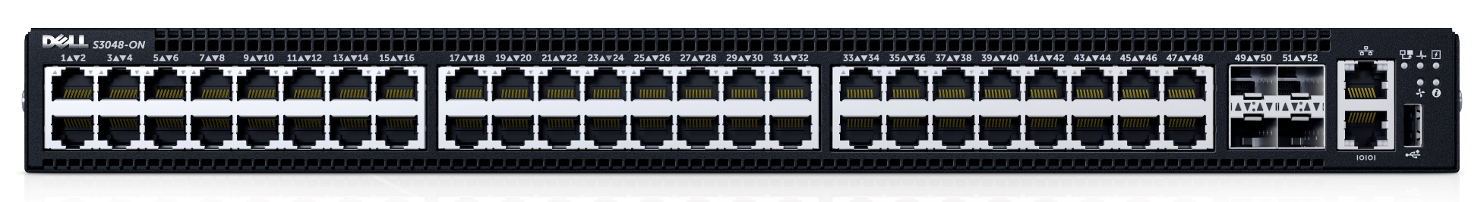
1GbE ToR Switch – S3048
Model | Features | Options | Users
Dell Networking S3048-ON | 48 x 1000BaseT 4 x 10Gb SFP+ | Redundant hot-swap PSUs & fans | 1Gb connectivity (iDRAC)
 | Non-blocking, line-rate performance | VRF-lite, Routed VLT, VLT Proxy Gateway
 | 260Gbps full-duplex bandwidth | User port stacking (up to 6 switches)
 | 131 Mbps forwarding rate | Open Networking Install Environment (ONIE)

Slide 20
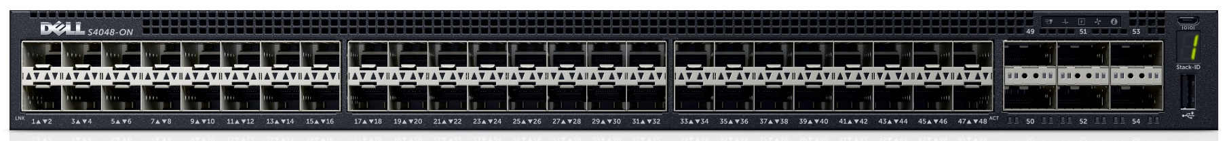
10GbE ToR Switch – S4048
Model | Features | Options | Users
Dell Networking S4048-ON | 48 x 10Gb SFP+ 6 x 40Gb QSFP+ | Redundant hot-swap PSUs & fans | 10Gb connectivity
 | Non-blocking, line-rate performance | 72 x 10Gb SFP+ ports with breakout cables
 | 1.44Tbps bandwidth 720 Gbps forwarding rate | User port stacking (up to 6 switches)
 | VXLAN gateway support | Open Networking Install Environment (ONIE)

Slide 21
Dell EMC VxRail Appliance network configuration
Notes:
The network configuration for the Dell EMC VxRail Appliances utilizes a 10GbE converged infrastructure model. All required VLANs will traverse 2 x 10 GbE NICs configured in an active/ active team. For larger scaling it is recommended to separate the infrastructure management VMs from the compute VMs to aid in predictable compute host scaling. The following outlines the VLAN requirements for the Compute and Management hosts in this solution model:
• VxRail Appliance VLAN configuration
o Management VLAN: Configured for hypervisor infrastructure traffic – L3 routed via core switch
o VDI VLAN: Configured for VDI session traffic – L3 routed via core switch
o VMware vSAN VLAN: Configured for VMware vSAN traffic – L2 switched only via ToR switch
o vMotion VLAN: Configured for Live Migration traffic – L2 switched only, trunked from Core (HA only)
o VDI Management VLAN: Configured for VDI infrastructure traffic – L3 routed via core switch
• A VLAN for iDRAC is configured for all hardware management traffic – L3 routed via core switch
The following screenshot shows the VMkernel adapter for the management network (vmk0), vMotion and VMware vSAN Network (vmk2) on a distributed switch

Slide 22
Scale from 3 to 64 nodes
LAG
10 Gb/s
MLAG
40 Gb/s
Notes:
The figure shows a design of a scale-out Leaf-Spine network architecture that provides 20 GB active throughput from each node to its Leaf and scalable 80 GB active throughput from each Leaf to Spine switch providing scale from 3 VxRail Appliance nodes to 64 without any impact to available bandwidth:

Slide 23
Cluster Design – Standard
Notes:
Dell recommends that the VDI management infrastructure nodes be separated from the compute resources, in this configuration both management and compute are in the same vSphere HA Cluster. Optionally, the management node can be used for VDI VMs as well with an expected reduction of 30% for these nodes only. The 30% accounts for the amount of resources needed to be reserved for management VMs so this needs to be factored in when sizing. Compute hosts can be used interchangeably for Horizon or RDSH as required.

Slide 24
Cluster Design – With vGPU
Notes:
High-performance graphics capabilities come with VxRail Appliance V Series platform and provide a superior user experience with vSphere 6 and NVIDIA GRID vGPU technology.

Slide 25
VMware NSX

Slide 26
V Series VDI-optimized configurations
A3
B5
C7
CPU: 2 X 10-Core (4114)
RAM: 192GB (12 X 16GB @ 2400MHz)
Disk: 4TB+ (Capacity*)
GPU (Optional**): Up to 3 x FLDW
CPU: 2 X 14-Core (5120)
RAM: 384GB (12 X 32GB @ 2400MHz)
Disk: 6TB+ (Capacity*)
GPU (Optional**): Up to 3 x FLDW
CPU: 2 X 20-Core (6138)
RAM: 768GB (24 X 16GB @ 2667MHz)
Disk: 8TB+ (Capacity*)
GPU (Optional**): Up to 3 x FLDW
Notes:
The VxRail Appliance family, optimized for VDI, has been designed and arranged in three top-level overarching configurations which apply to the available physical platforms showcased below.
* The A3 configuration is perfect for small scale, POC or low density, cost-conscience environments.
* The B5 configuration is geared toward larger scale general purpose workloads, balancing performance and cost-effectiveness.
* The C7 is the premium configuration offering an abundance of high-performance features and tiered capacity that maximizes user density.

Slide 27
V570/V570F A3 NUMA alignment
Notes:
Best practices and testing has showed that aligning RDSH design to the physical Non-Uniform Memory Access (NUMA) architecture of the server CPUs results in increased and optimal performance. NUMA alignment ensures that a CPU can access its own directly-connected RAM banks faster than those banks of the adjacent processor, which are accessed via the UltraPath Interconnect (UPI). The same is true of VMs with large vCPU assignments, best performance will be achieved if your VMs receive their vCPU allotment from a single physical NUMA node. Ensuring that your virtual RDSH servers do not span physical NUMA nodes will ensure the greatest possible performance benefit.
The general guidance for RDSH NUMA-alignment on the Dell EMC VxRail Appliance is as follows:
10 physical cores per CPU in the V570/V570F A3 configuration, 20 logical with Hyper-threading active, gives us a total of 20 consumable cores per appliance.

Slide 28
V570/V570F B5 NUMA alignment
Notes:
Best practices and testing has showed that aligning RDSH design to the physical Non-Uniform Memory Access (NUMA) architecture of the server CPUs results in increased and optimal performance. NUMA alignment ensures that a CPU can access its own directly-connected RAM banks faster than those banks of the adjacent processor, which are accessed via the UltraPath Interconnect (UPI). The same is true of VMs with large vCPU assignments, best performance will be achieved if your VMs receive their vCPU allotment from a single physical NUMA node. Ensuring that your virtual RDSH servers do not span physical NUMA nodes will ensure the greatest possible performance benefit.
The general guidance for RDSH NUMA-alignment on the Dell EMC VxRail Appliance is as follows:
14 physical cores per CPU in the V570/V570F B5 configuration, 28 logical with Hyper-threading active, gives us a total of 56 consumable cores per appliance.

Slide 29
V570/V570F C7 NUMA Alignment
Notes:
Best practices and testing has showed that aligning RDSH design to the physical Non-Uniform Memory Access (NUMA) architecture of the server CPUs results in increased and optimal performance. NUMA alignment ensures that a CPU can access its own directly-connected RAM banks faster than those banks of the adjacent processor, which are accessed via the UltraPath Interconnect (UPI). The same is true of VMs with large vCPU assignments, best performance will be achieved if your VMs receive their vCPU allotment from a single physical NUMA node. Ensuring that your virtual RDSH servers do not span physical NUMA nodes will ensure the greatest possible performance benefit.
The general guidance for RDSH NUMA-alignment on the Dell EMC VxRail Appliance is as follows:
20 physical cores per CPU in the V570/V570F C7 configuration, 40 logical with Hyper-threading active, gives us a total of 80 consumable cores per appliance.

Slide 30
NVIDIA GRID vGPU

Slide 31
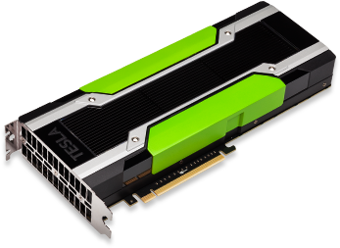
GPUs – M10
Specs | Tesla M10
Number of GPUs/ card | 4 x NVIDIA Maxwell™ GPUs
Total CUDA cores | 2560 (640 per GPU)
GPU Clock | Idle: 405MHz / Base: 1033MHz
Total memory size | 32GB GDDR5 (8GB per GPU)
Max power | 225W
Form Factors | Dual slot (4.4” x 10.5”)
Aux Power | 8-pin connector
PCIe | x16 (Gen3)
Cooling Solution | Passive
Notes:
http://images.nvidia.com/content/pdf/tesla/PB-08118-001_v03_TeslaM10-Product-Brief_12-16.pdf

Slide 32
GPUs – M60
Specs | Tesla M10
Number of GPUs/ card | 2 x NVIDIA Maxwell™ GPUs
Total CUDA cores | 4096 (2048 per GPU)
GPU Clock | 899 MHz (Max: 1178 MHz)
Total memory size | 16GB GDDR5 (8GB per GPU)
Max power | 300W
Form Factors | Dual slot (4.4” x 10.5”)
Aux Power | 8-pin connector
PCIe | x16 (Gen3)
Cooling Solution | Passive
Notes:
http://images.nvidia.com/content/pdf/tesla/PB-07864-001_v02_TeslaM60-Product-Brief_12-16.pdf

Slide 33
Tesla M10 GRID vGPU Profiles
Card | vGPU Profile | Graphics Memory (Frame Buffer) | Virtual Display Heads | Maximum Resolution | Maximum Graphics-Enabled VMs
 |  |  |  |  | Per GPU | Per Card | Per Server (2 Cards)
Tesla M10 | M10-8Q | 8GB | 4 | 4096x2160 | 1 | 4 | 8
 | M10-4Q | 4GB | 4 | 4096x2160 | 2 | 8 | 16
 | M10-2Q | 2GB | 4 | 4096x2160 | 4 | 16 | 32
 | M10-1Q | 1GB | 2 | 4096x2160 | 8 | 32 | 64
 | M10-0Q | 512MB | 2 | 2560x1600 | 16 | 64 | 128
 | M10-1B | 1GB | 4 | 2560x1600 | 8 | 32 | 64
 | M10-0B | 512GB | 2 | 2560x1600 | 16 | 64 | 128
 | M10-8A | 8GB | 1 | 1280x1024 | 1 | 4 | 8
 | M10-4A | 4GB | 1 | 1280x1024 | 2 | 8 | 16
 | M10-2A | 2GB | 1 | 1280x1024 | 4 | 16 | 32
 | M10-1A | 1GB | 1 | 1280x1024 | 8 | 32 | 64

Slide 34
GPU – M10 Supported Guest OS
Card | vGPU Profile | Guest VM OS Supported* |  | Grid License Required
 |  | Win | 64bit Linux
Tesla M10 | M10-8Q | ● | ● | NVIDIA® Quadro® Virtual Data Center Workstation
 | M10-4Q | ● | ●
 | M10-2Q | ● | ●
 | M10-1Q | ● | ●
 | M10-0Q | ● | ●
 | M10-1B | ● |  | GRID Virtual PC
 | M10-0B | ●
 | M10-8A | ● |  | GRID Virtual Application
 | M10-4A | ●
 | M10-2A | ●
 | M10-1A | ●
Supported Guest VM Operating Systems*
Windows | Linux
Windows 7 (32/64-bit) | RHEL 6.6 & 7
Windows 8.x (32/64-bit) | CentOS 6.6 & 7
Windows 10 (32/64-bit) | Ubuntu 12.04 & 14.04 LTS
Windows Server 2008 R2
Windows Server 2012 R2
Windows Server 2016
*NOTE: Supported guest operating systems listed as of the time of this writing. Please refer to NVIDIA’s documentation for latest supported operating systems.

Slide 35
Tesla M60 GRID vGPU Profiles
Card | vGPU Profile | Graphics Memory (Frame Buffer) | Virtual Display Heads | Maximum Resolution | Maximum Graphics-Enabled VMs
 |  |  |  |  | Per GPU | Per Card | Per Server (3 Cards)
Tesla M60 | M60-8Q | 8GB | 4 | 4096x2160 | 1 | 2 | 6
 | M60-4Q | 4GB | 4 | 4096x2160 | 2 | 4 | 12
 | M60-2Q | 2GB | 4 | 4096x2160 | 4 | 8 | 24
 | M60-1Q | 1GB | 2 | 4096x2160 | 8 | 16 | 48
 | M60-0Q | 512MB | 2 | 2560x1600 | 16 | 32 | 96
 | M60-1B | 1GB | 4 | 2560x1600 | 8 | 16 | 48
 | M60-0B | 512GB | 2 | 2560x1600 | 16 | 31 | 96
 | M60-8A | 8GB | 1 | 1280x1024 | 1 | 2 | 6
 | M60-4A | 4GB | 1 | 1280x1024 | 2 | 4 | 12
 | M60-2A | 2GB | 1 | 1280x1024 | 4 | 8 | 24
 | M60-1A | 1GB | 1 | 1280x1024 | 8 | 16 | 48

Slide 36
GPU – M60 Supported Guest OS
Card | vGPU Profile | Guest VM OS Supported* |  | Grid License Required
 |  | Win | 64bit Linux
Tesla M10 | M60-8Q | ● | ● | NVIDIA® Quadro® Virtual Data Center Workstation
 | M60-4Q | ● | ●
 | M60-2Q | ● | ●
 | M60-1Q | ● | ●
 | M60-0Q | ● | ●
 | M60-1B | ● |  | GRID Virtual PC
 | M60-0B | ●
 | M60-8A | ● |  | GRID Virtual Application
 | M60-4A | ●
 | M60-2A | ●
 | M60-1A | ●
Supported Guest VM Operating Systems*
Windows | Linux
Windows 7 (32/64-bit) | RHEL 6.6 & 7
Windows 8.x (32/64-bit) | CentOS 6.6 & 7
Windows 10 (32/64-bit) | Ubuntu 12.04 & 14.04 LTS
Windows Server 2008 R2
Windows Server 2012 R2
Windows Server 2016
*NOTE: Supported guest operating systems listed as of the time of this writing. Please refer to NVIDIA’s documentation for latest supported operating systems.

Slide 37
GRID vGPU Licensing
NVIDIA® GRID® Virtual Applications | NVIDIA® GRID® Virtual PC | NVIDIA® Quadro® Virtual Data Center Workstation
For organizations deploying RDSH solutions. Designed to deliver Windows applications at full performance. | For users who need a virtual desktop, but also need a great user experience leveraging PC applications, browsers, and high-definition video. | For users who need to use professional graphics applications with full performance on any device, anywhere.
Up to 2 displays @ 1280x1024 resolution supporting virtualized Windows applications | Up to 4 displays @ 2560x1600 resolution supporting Windows desktops, and NVIDIA Quadro features | Up to 4 displays @4096x2160* resolution supporting Windows or Linux desktops, NVIDIA Quadro, CUDA**, OpenCL** & GPU pass-through
*0Q profiles only support up to 2560x1600 resolution
**CUDA and OpenCL only supported with M10-8Q, M10-8A, M60-8Q, or M60-8A profiles

Slide 38
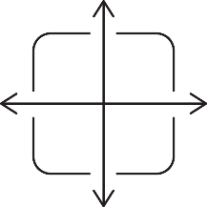

All-Flash vs. Hybrid Storage
VMware vSAN
x
=
VM Size | FTM | FTT | Overhead | Configuration | Capacity Required | Host Required
50GB | RAID-1 | 1 | 2x | Hybrid | 100GB | 3
50GB | RAID-5 | 1 | 1.33x | All-Flash | 66.5GB | 4
50GB | RAID-1 | 2 | 3x | All-Flash | 150GB | 4
50GB | RAID-6 | 2 | 1.5x | All-Flash | 75GB | 6
Notes:
The most signification new features in this latest version of VMware vSAN are Deduplication & Compression and erasure coding. These features are only supported in an All-Flash VMware vSAN configuration. The hesitance of a customer going the all flash route is cost but if you factor in the capacity savings achieved by these new features it bridges the gap between the Hybrid & All Flash configurations.
The scenario below is using a VM which consumes 50 GB of space. The hybrid configuration has a default FTT value of 1 and Failure Tolerance Method (FTM) of RAID-1 which has 2x overhead and with FTT=2 that has 3x overhead. The FTM of RAID5/6 is only available with the all-flash configuration and with FTT=1 the overhead is 1.33x, for FTT=2 is 1.5x.
Comparing both FTT=1 scenarios below for both the hybrid and all-flash we can see the capacity savings of over 33GBs per VM so if we had 200VMs per Host that’s a capacity saving of over 660GB of usable VM space per Host.

Slide 39
Knowledge Worker, 155 users, ESXi 6.5, Horizon 7.x Instant Clones
With VMware vSphere Horizon
Notes:
The below graph shows the performance data for 155 user sessions per host. The CPU reaches a steady state average of 95 % across the two compute hosts during the test cycle when 155 users were logged on to each compute host.

Slide 40
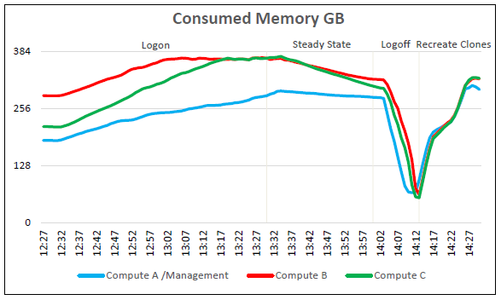
Consumed Memory
With VMware vSphere Horizon
Notes:
In regards to memory consumption for the cluster, out of a total of 384 GB available memory per node, memory usage was not pushed close to its maximum usage. The compute hosts reached a maximum memory consumption of 373 GB with active memory usage reaching a max of 372 GB during the recreation of the instant clones. A tiny amount of ballooning took place on one host for approximately 8 minutes and reached a peak of 1.2 GB. There was no memory swapping on any of the hosts and memory usage was not a constraint on the system’s resources during the test run, before the instant clone recreation.

Slide 41
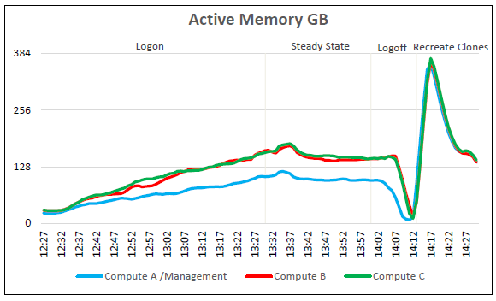
Active Memory
With VMware vSphere Horizon

Slide 42
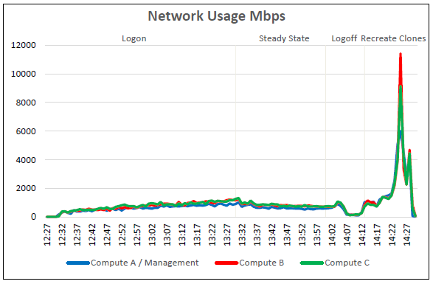
Network Bandwidth
With VMware vSphere Horizon
Notes:
Network bandwidth is not an issue on this test run with a steady state peak of approximately 1,335 Mbps. The busiest period for network traffic was during the recreation of the instant clones after testing had completed. One of the hosts reached a peak of 11,400 Mbps during the deletion and recreation of the instant clones.

Slide 43
Cluster Storage Performance
With VMware vSphere Horizon
Notes:
The IOPS graphs and IOPS numbers are taken from the vCenter web console and the graphs clearly display the initial logon if the desktops, the steady state and logoff phases and finally the recreation of the desktops after testing was complete. The graph displays the Disk IOPS figure for the VSAN cluster.
The cluster reached a maximum of 5,974 Disk IOPS during the instant clone recreation period after testing and 3,320 IOPS at the start of steady state.
Disk I/O Latency was not an issue during the Login VSI testing period of this test run. The maximum latency reached was approximately 1.6 ms at the beginning of steady state. This was well below the 20 ms threshold that is regarded as becoming potentially troublesome. During the instant clone recreation however there was a large latency spike reaching a peak of 38.8 ms which was somewhat expected during the instant clone recreation.

Slide 44
Login VSI Max User Experience Score
With VMware vSphere Horizon
Notes:
The Login VSI Max user experience score shown below for this test was not reached indicating that the number of users tested is appropriate for this configuration. Manually interacting with the desktop sessions showed mouse response and switching between windows to be quick and smooth and video playback was of good quality.

Slide 45
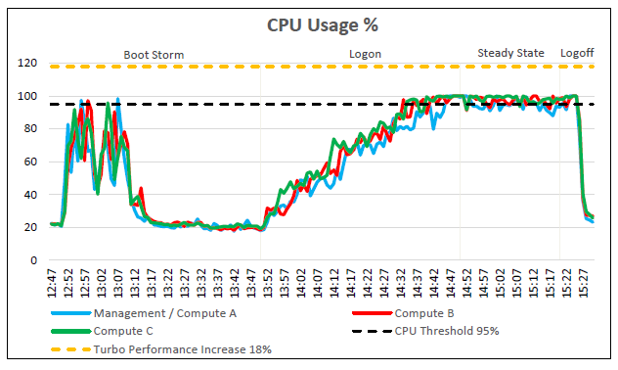
Knowledge Worker, 140 users, ESXi 6.5, XD 7.15, MCS Linked Clones
With Citrix XenDesktop
Notes:
Knowledge Worker, 140 users, ESXi 6.5, XD 7.15, MCS Linked Clones
Each compute host was populated with 140 virtual machines per host and the combined Management / Compute host was populated with 130 user vm’s. The combined Management / Compute host also hosted the VxRail Manager VM, vCenter VM and a Platform Services Controller VM. With all user virtual machines powered on and before starting test, the CPU usage was approximately 20% on the dedicated compute hosts. The CPU consumption of the management VM’s was minimal during the testing period. We see that increasing the amount of VM’s on the management host has an impact on the compute hosts user density, so even though we have 140 per compute host
The below graph shows the performance data for 140 user sessions per host. The CPU reaches a steady state average of 97.7% across the two compute hosts during the test cycle when 140 users were logged on to each compute host.

Slide 46
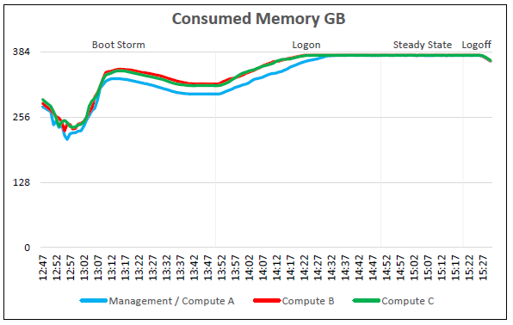
Consumed Memory
With Citrix XenDesktop
Notes:
In regards to memory consumption for the cluster, out of a total of 384 GB available memory per node, memory usage was pushed close to its maximum. The compute hosts reached a maximum memory consumption of 378 GB with active memory usage reaching a max of 306 GB. Some ballooning occurred on the hosts which began approximately 20 minutes into the logon phase and ended during the logoff phase. The maximum amount of memory ballooning was approximately 46 GB. There was also some memory swapping on all of the hosts, this reached a peak of 2.5 GB.

Slide 47
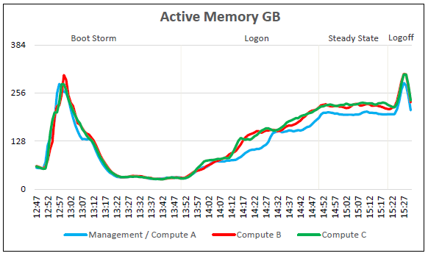
Active Memory
With Citrix XenDesktop

Slide 48
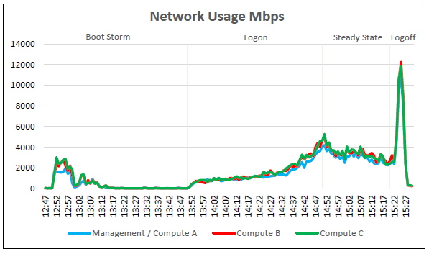
Network Usage
With Citrix XenDesktop
Notes:
Network bandwidth is not an issue on this test run with a steady state peak of approximately 5,287 Mbps on the Compute hosts. The busiest period for network traffic was during logoff phase after testing had completed. One of the hosts reached a peak of 12,265 Mbps during the logoff phase at the end of testing.

Slide 49
Storage Performance
With Citrix XenDesktop
Notes:
The IOPS graphs and IOPS numbers are taken from the vCenter web console and the graphs clearly display the boot storm, the initial logon of the desktops then the steady state and finally the logoff phase. The graph displays the Disk IOPS figure for the VSAN cluster.
The cluster reached a maximum of 27,878 Disk IOPS during the reboot of all the VM’s before test start and 7,340 IOPS at the start of steady state.
Disk I/O Latency was not an issue during the Login VSI testing period of this test run. The maximum latency reached was approximately 22 ms during the logoff phase and 7 ms at the beginning of steady state. This steady state number was well below the 20 ms threshold that is regarded as becoming potentially troublesome and the 22 ms figure was recorded while all the VM’s were logging off together and so was to be somewhat expected.

Slide 50
VSI Max User Experience Score
With Citrix XenDesktop

Slide 51


Get better user performance with Dell EMC & Horizon
Great SLAs
Great productivity
Great user experience
CENTCOM has achieved 100 percent uptime
American Red Cross, is saving more lives as a result of increased productivity
NC State University is supporting one of the top 20 game-design programs in the country
Notes:
-*US Central Command -Centcom- has deployed more than 10K Horizon desktops on Dell PowerEdge servers (VxRail???) saving as much as $160M in hardware costs (no Storage area networks required) and vastly streamlining desktop management- they are able to deploy desktops in a fraction of the time and assign apps on the fly.
American Red Cross couldn’t keep their traditional desktops deployments up to date and had issues with access to apps and compatibility. It was getting out of control. They moved 10K users to a virtual workspace powered by Horizon in just 6 months and used tools like ThinApp to ensure legacy apps would run on the latest operating system. It also gives volunteers access to a red cross digital workspace through any device, which makes them productive much quicker hat having to get volunteer station set up and devices passout. It’s changed their business for the better.
NC State University- they are using Horizon virtualized apps and desktops platform with hyperconverged infrastructure equipped with NVIDIA GRID technology to deliver gaming design apps to their students. Students can access these sophisticated applications with their own devices. It is more cost effective because they are able to efficiently allocate Licenses across students and only purchase what they actually need. It’s a fantastic use case –because if you can take down this use case, you can take down any use case.
---------------
CENTCOM’s deployment of VMware’s Horizon desktop virtualization solution was successfully adopted and the organization continues to roll out new desktops, having deployed more than 10,000 over time. The new environment makes more efficient use of resources by requiring less Storage Area Network (SAN) space, saving as much as $160 million in hardware costs. The VMware solution also allowed CENTCOM to standardize desktop deployments for about 60 percent of its users, which makes it easier for IT to manage the environment and improves security.
In addition, the new environment allows new desktop images to be deployed in just 8 hours compared to the old system’s one week per network. This improved efficiency enables CENTCOM to reallocate IT technicians to areas that need more support. It has also made it possible for users to request new applications and have the new software within minutes, instead of 3-5 weeks as on the old platform.
Another improvement to the user experience is that users can log in and view their desktops in 30-45 seconds. This increase in availability combined with the integrated virtual 3D graphics card allows users to respond in real-time to military situations. VMware’s Horizon solution is robust enough to deliver 100 percent uptime which CENTCOM requires for its mission.

Slide 52
Horizon 7 – portfolio overview
Horizon Standard
Horizon Advanced
Horizon Enterprise
Simple powerful VDI with great user experience
Low-cost, high performance desktops and applications for physical and virtual machines
Highest level of
automation and management
for private cloud delivery
Advanced
Notes:
All the editions provide vSphere and vCenter for the underlying infrastructure on which to host the desktops.
Drilling down into the editions, Std edition provides simple, powerful Virtual Desktop. Advance Edition adds Virtualized apps, Image management and Virtual SAN. Enterprise Edition includes just-in time desktops and app delivery (from App Volumes and instant clone technology), Personalization and personalized Policy (from UEM), and performance monitoring for quick troubleshooting and proactive management of your virtual desktop and apps environment (from vRealize operations for Horizon)

Slide 53
Horizon Apps – portfolio overview
Horizon Apps Standard
Horizon Apps Advanced
Simple powerful app virtualization with a great user experience
Powerful app virtualization with Just-in-Time management
Advanced
Notes:
All the editions provide vSphere and vCenter for the underlying infrastructure on which to host the desktops.
Drilling down into the editions, Std edition provides simple, powerful Virtual Desktop. Advance Edition adds Virtualized apps, Image management and Virtual SAN. Enterprise Edition includes just-in time desktops and app delivery (from App Volumes and instant clone technology), Personalization and personalized Policy (from UEM), and performance monitoring for quick troubleshooting and proactive management of your virtual desktop and apps environment (from vRealize operations for Horizon)

Slide 54








Growing demand for graphics resources
2x
>60%
85%
Number of applications that require graphics doubled since 2012*
Over 60% of enterprise users access at least one graphics accelerated app*
Majority of enterprises will have started Windows 10 deployments by end of Jan 2017**
Source:
* Data from Lakeside Software’s SysTrack Community, 2017
** Gartner. April 25, 2017. "Gartner Survey Shows 85 Percent of Enterprises Will Have Started Windows 10 Deployments by End of 2017." [Press release]. Retrieved from http://www.gartner.com/newsroom/id/3690917

Slide 55
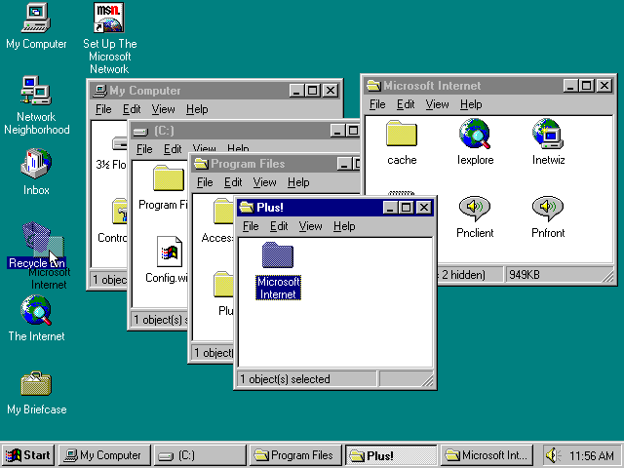
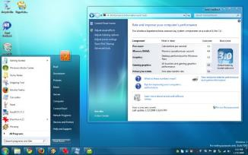
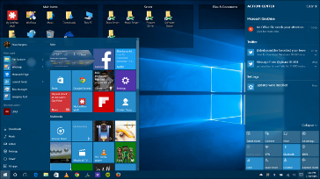






Windows 10 and Modern Apps Highest graphics requirement from any operating system to date
Windows 95
Windows 7
Windows 10
32% Increase in CPU Consumption, Windows 10 vs Windows 7*
36%
53%
59%
64%
85%
409%
Increase in graphics usage Windows 7 vs Windows 10
*Percent of time consuming GPU (DirectX or OpenGL)
Source: Lakeside Software, Inc. "Elevating User Experience Through GPU Acceleration: A Windows 10 versus Windows 7 Analysis." Lakeside Software White Paper. 2017
Notes:
Windows 10 has the highest graphics usage of any operating system to date. We’ve been working with one of our partners, Lakeside, and they have found that, compared to Windows 7, Windows 10 consumes 32% more GPU. Lakeside determined the increase in GPU resource requirement by measuring the percent of time the OS is consuming GPU, making DirectX or OpenGL calls.
We expect that the GPU requirements of Windows 10 will continue to increase as MS continues to evolve this release.

Slide 56


NVIDIA Virtual GPU solutions deliver rich immersive user experiences
GRID vPC and GRID vApps
Powered by the NVIDIA Tesla M10*
Quadro Virtual Data Center Workstation
Powered by the NVIDIA Tesla M60*
Apps
Meet the demanding performance needs of professional visualization users
Enable broad workflow collaboration while securing data in the data center
Quadro driver optimizations and capability
Deliver native user experiences across multiple devices
Support rising graphics requirements of productivity apps and Windows 10
Enhance user experience quality by 34%**
*NVIDIA virtual GPU software sold separately through Dell S&P and supported by NVIDIA directly
**Based on User Experience testing by NVIDIA

Slide 57















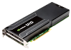
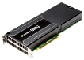
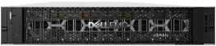

How the NVIDIA GRID Solution works
Virtual Machine
Virtual Machine
Virtual Machine
Virtual Machine
Windows or Linux OS
Windows or Linux OS
Windows OS
Windows OS
NVIDIA Quadro Driver
NVIDIA Quadro Driver
NVIDIA Graphics Driver
NVIDIA Graphics Driver
Quadro vDWS Profile
Quadro vDWS Profile
GRID vPC Profile
GRID vPC Profile
vGPU
vGPU
vGPU
vGPU
Hypervisor
NVIDIA virtualization software*
*NVIDIA GRID vPC and Quadro vDWS software, purchased separately to enable accelerated graphics and compute workloads across multiple VMs.

